Slide 1
Big Data Analytics
Fundamentals

Slide 2
Agenda Day 1
Lab Setup: Installation
What is big data?
Characteristics of big data (volume, variety, velocity, veracity).
What is Big Data Analytics?
Importance of big data analytics in today's data-driven world.
Real-world use cases of big data analytics across various industries
Introduction to distributed computing frameworks (Hadoop, Spark).

Slide 3
Agenda Day 2
Exploring data storage solutions: HDFS, data warehouses, data lakes.
Understanding data processing tools: MapReduce, Spark SQL.
Why Python is a popular choice for big data analytics.
Introduction to essential Python libraries for data analysis (NumPy, pandas, matplotlib).
Hands-on Lab: Setting up Python environment and exploring NumPy, pandas for data manipulation and visualization.
The importance of data cleaning and preparation before analysis.
Techniques for handling missing values, outliers, and data inconsistencies.
Transforming and shaping data for effective analysis.

Slide 4
Agenda Day 3
Advantages of Apache Spark for big data processing.
Understanding Spark architecture (RDDs, dataframes, datasets).
Hands-on Lab: Setting up a Spark environment and working with Spark RDDs for basic operations.
Using Spark SQL for querying structured data stored in HDFS or data warehouses.
Performing data analysis tasks like filtering, grouping, and aggregation with Spark SQL.
Hands-on Lab: Querying sample datasets using Spark SQL to extract insights.
Visualization

Slide 5
Training Format
Concepts
Hands-on exercises
Challenge/Assignments 15 to 20 min
Interactive

Slide 6
Timing
Start time at 8.30 pm IST
Break 1 - 9.40 pm to 10.00 pm
Break 2 - 11.10 pm to 11.30 pm
End at 12.30 am

Slide 7
Installation
VS Code
Python
Docker

Slide 8
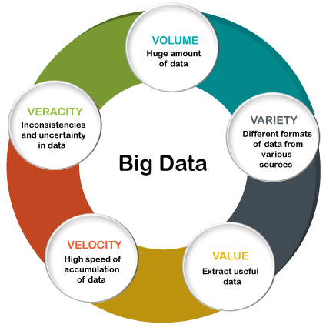
Big Data
Big data refers to large, complex datasets that cannot be effectively managed, processed, or analyzed using traditional data processing applications.
It encompasses three key dimensions commonly referred to as the three Vs:
volume,
velocity,
variety,
veracity
value

Slide 9
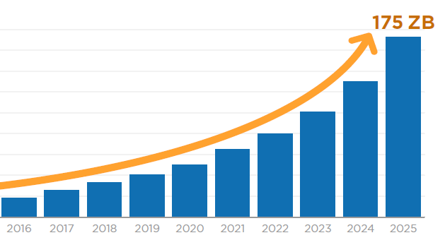
Big Data: Volume
Big data involves vast amounts of data generated from various sources, including
business transactions,
social media interactions,
sensor data,
machine-to-machine data, and more.
The sheer volume of data exceeds the capabilities of traditional database systems to store and manage efficiently.
This necessitates scalable storage solutions like distributed file systems and NoSQL databases.

Slide 10
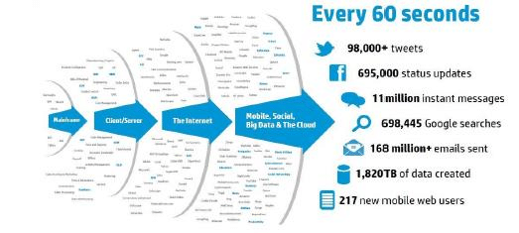
Big Data: Velocity
Big data is generated at high speed and must be processed quickly to extract timely insights.
Examples of high-velocity data include:
real-time sensor data,
social media updates,
financial transactions, and
website clickstreams.
Technologies like stream processing and real-time analytics platforms enable organizations to analyze data as it is being generated to make rapid decisions.

Slide 11
Big Data: Variety
Big data comes in diverse formats and types, including:
structured,
semi-structured, and
unstructured data.
Structured data follows a predefined format and is typically stored in relational databases.
Semi-structured data, such as XML and JSON, has some organizational properties but does not conform to a strict schema.
Unstructured data lacks a predefined structure and can include text documents, images, videos, and more. Managing and analyzing such diverse data types requires flexible data storage and processing solutions.

Slide 12
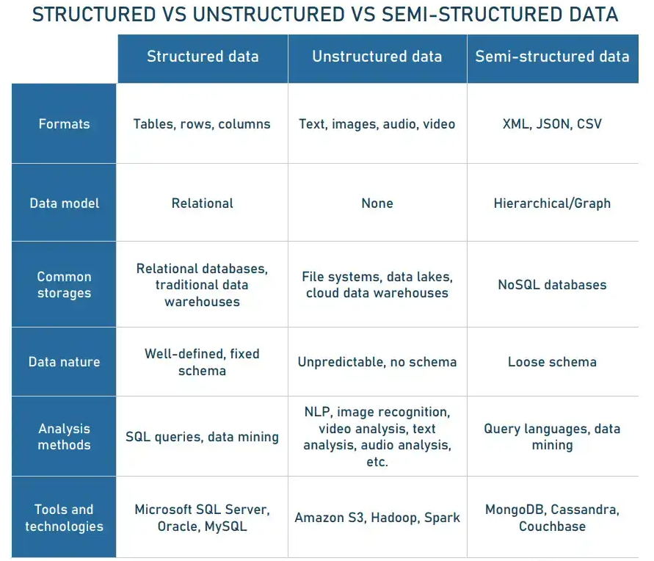
Types of Data
Data types have evolved over time to accommodate the diverse forms and sources of information.
The evolution of data types reflects the increasing complexity and diversity of data sources and the need for more adaptable storage and processing solutions to extract insights effectively.

Slide 13
Big Data: Veracity
Veracity refers to the:
quality,
accuracy, and
reliability of the data.
Big data often includes
noisy,
incomplete, or
inconsistent data from various sources.
posing challenges for analysis and decision-making.
Data quality and integrity must be ensured through data cleansing, validation, and quality assurance processes to derive accurate insights.

Slide 14
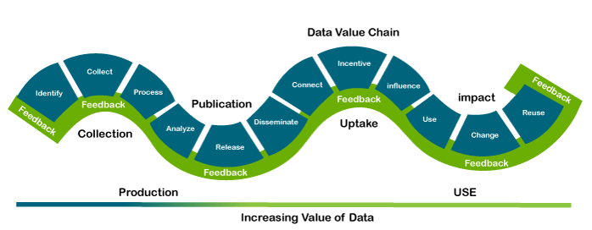
Big Data: Value
Value is an essential characteristic of big data. It is not the data that we process or store. It is valuable and reliable data that we store, process, and also analyze.

Slide 15
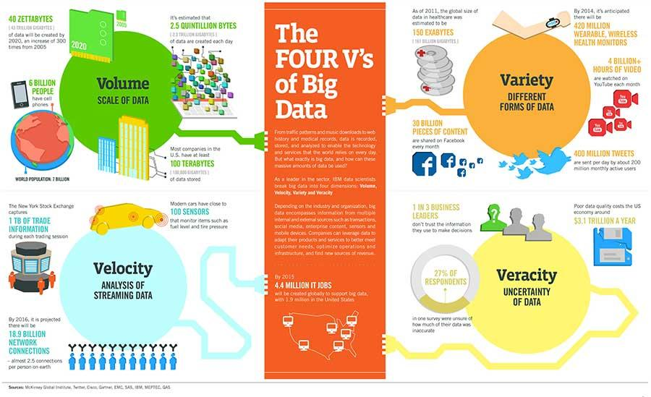

Slide 16
Big Data Generated from major Industries
Big data is generated across various industries as a result of digital transformation and the increasing adoption of technology in business processes. Here's a list of major industries where big data is commonly generated:
1. Finance and Banking: Financial institutions generate big data from transactions, customer interactions, market data, risk assessments, fraud detection, and regulatory compliance.
2. Healthcare and Life Sciences: Healthcare organizations produce big data from electronic health records (EHRs), medical imaging, wearable devices, genomic data, clinical trials, and patient monitoring systems.

Slide 17
Big Data Generated from major Industries
3. Retail and E-commerce: Retailers and e-commerce companies generate big data from sales transactions, customer interactions, website traffic, inventory management, supply chain operations, and marketing campaigns.
4. Telecommunications: Telecommunications companies produce big data from call detail records (CDRs), network traffic, customer interactions, location data, and device telemetry.
5. Manufacturing and Industrial: Manufacturing companies generate big data from production processes, sensor data, equipment telemetry, supply chain logistics, quality control, and predictive maintenance.

Slide 18
Big Data Generated from major Industries
5. Manufacturing and Industrial: Manufacturing companies generate big data from production processes, sensor data, equipment telemetry, supply chain logistics, quality control, and predictive maintenance.
6. Energy and Utilities: Energy and utility companies produce big data from smart meters, grid operations, sensor data from infrastructure, energy consumption patterns, and predictive maintenance of equipment.
7. Transportation and Logistics: Transportation and logistics companies generate big data from vehicle telemetry, GPS tracking, route optimization, shipment tracking, supply chain visibility, and fleet management.

Slide 19
Big Data Generated from major Industries
8. Media and Entertainment: Media and entertainment companies produce big data from digital media consumption, streaming services, social media interactions, content recommendations, and audience analytics.
9. Government and Public Sector: Government agencies and public sector organizations generate big data from census data, administrative records, geospatial data, public services, law enforcement, and regulatory compliance.
10. Education: Educational institutions generate big data from student records, learning management systems, online courses, assessments, research data, and academic performance metrics.

Slide 20
Big Data Generated from major Industries
Insurance
Hospitality and Travel
Marketing and Advertising
Agriculture
Real Estate

Slide 21
Big Data Analytics
Big data analytics is the process of analyzing large and complex datasets to uncover:
patterns,
trends,
correlations, and
Customer preferences
Meaningful/actionable information
other valuable insights
Which helps organizations make better decisions and solve problems.

Slide 22
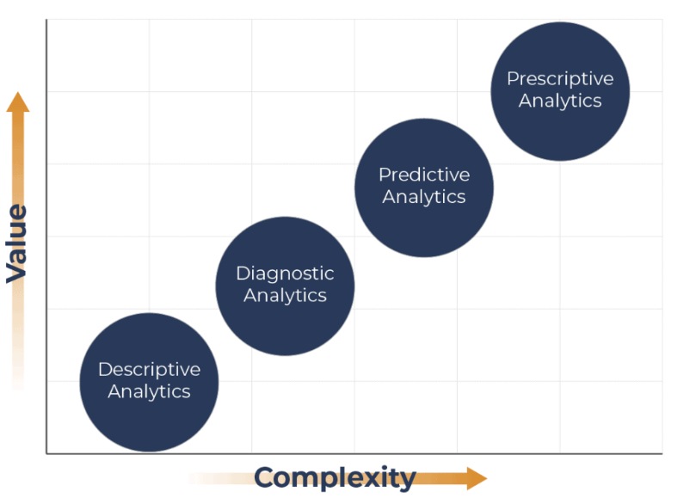
Types of Analytics

Slide 23
Descriptive Analytics
Descriptive analytics is a branch of analytics that focuses on summarizing and interpreting historical data to gain insights into past events, trends, and patterns.
It aims to answer the question "What happened?" by providing a comprehensive overview of the data and its characteristics.
Descriptive analytics forms the foundation of data analysis and is often the first step in the analytics process.
descriptive analytics provides valuable insights into historical data that can inform decision-making, support strategic planning, and drive business success.

Slide 24
key aspects of descriptive analytics
Data Summarization:
Descriptive analytics involves summarizing large and complex datasets into more manageable and understandable formats. This includes calculating summary statistics such as mean, median, mode, range, variance, and standard deviation to describe the central tendency, dispersion, and distribution of the data.
Data Visualization:
Visualization techniques such as charts, graphs, histograms, heatmaps, and dashboards are commonly used in descriptive analytics to represent data visually. Visualizations help identify trends, patterns, and outliers in the data more effectively than tabular formats.

Slide 25
key aspects of descriptive analytics
Data Exploration:
Descriptive analytics allows analysts to explore the underlying structure and relationships within the data. This involves examining different dimensions and attributes of the data to uncover insights and identify potential correlations or dependencies.
Pattern Recognition:
By analyzing historical data, descriptive analytics can reveal recurring patterns, trends, and anomalies that provide valuable insights into past behavior or performance. This information can be used to understand customer preferences, market dynamics, operational efficiencies, and more.

Slide 26
key aspects of descriptive analytics
Performance Monitoring:
Descriptive analytics is often used to monitor and track key performance indicators (KPIs) and metrics over time. By comparing current performance against historical benchmarks, organizations can assess their progress, identify areas for improvement, and make data-driven decisions.
Reporting and Dashboarding:
Descriptive analytics generates reports, summaries, and dashboards that communicate key findings and insights to stakeholders across the organization. These reports provide a snapshot of the current state of affairs and help support decision-making at various levels.

Slide 27
descriptive analytics in practice
Summarizing sales data by region, product category, or time period to identify trends and performance metrics.
Creating customer segmentation based on demographic characteristics, purchasing behavior, or engagement levels.
Analyzing website traffic patterns, clickstream data, and user interactions to understand website performance and user behavior.
Monitoring inventory levels, production output, and supply chain metrics to optimize operations and resource allocation.
Visualizing financial data such as revenue, expenses, and profitability to track financial performance and identify areas of concern.

Slide 28
Diagnostic Analytics
Diagnostic analytics is a branch of analytics that focuses on analyzing past data to identify the root causes of problems, anomalies, or unexpected events.
It aims to answer the question "Why did it happen?" by examining historical data in detail to understand the underlying factors and drivers that led to a particular outcome or issue.
Diagnostic analytics plays a critical role in uncovering insights into past performance, diagnosing problems, and informing corrective actions to address underlying issues.

Slide 29
key aspects of diagnostic analytics
Root Cause Analysis:
Diagnostic analytics involves conducting root cause analysis to investigate the underlying reasons or factors contributing to a specific outcome or event. It seeks to identify the primary causes or triggers that led to the observed behavior or result.
Pattern Recognition:
Diagnostic analytics examines historical data patterns, trends, and relationships to identify anomalies, deviations, or irregularities that deviate from expected norms or trends. It helps pinpoint areas of concern or areas where performance is suboptimal.

Slide 30
key aspects of diagnostic analytics
Correlation Analysis:
Diagnostic analytics assesses correlations and relationships between different variables, metrics, or factors to determine how changes in one variable impact others. This helps identify potential cause-and-effect relationships and dependencies.
Comparative Analysis:
Diagnostic analytics compares different segments, groups, or time periods to identify differences or discrepancies in performance. This includes comparing actual performance against benchmarks, targets, or historical baselines to assess performance relative to expectations.

Slide 31
key aspects of diagnostic analytics
Hypothesis Testing:
Diagnostic analytics formulates hypotheses or theories about the potential causes of observed outcomes and then tests these hypotheses using statistical methods and data analysis techniques. This helps validate assumptions and uncover insights into underlying drivers.
Drill-down Analysis:
Diagnostic analytics enables analysts to drill down into data at different levels of granularity, from high-level summaries to detailed transactional data. This allows for a more granular understanding of trends, patterns, and outliers within the data.

Slide 32
diagnostic analytics applications
Investigating Customer Complaints: Analyzing customer complaints data to identify common issues, trends, or patterns that may be indicative of underlying product or service problems.
Identifying Operational Bottlenecks: Analyzing production data to identify bottlenecks, inefficiencies, or quality issues in manufacturing processes and supply chains.
Root Cause Analysis of Equipment Failures: Investigating maintenance records and sensor data to identify root causes of equipment failures or breakdowns in industrial machinery or infrastructure.
Understanding Sales Performance Discrepancies: Analyzing sales data by region, product, or sales channel to understand variations in performance and identify factors influencing sales outcomes.
Analyzing Financial Performance Discrepancies: Investigating financial statements and transaction data to identify discrepancies, anomalies, or errors that may impact financial performance or reporting.

Slide 33
Predictive Analytics
Predictive analytics is a branch of advanced analytics that utilizes statistical algorithms, machine learning techniques, and data mining to forecast future events, behaviors, or trends based on historical data.
It aims to answer the question "What is likely to happen?" by analyzing patterns and relationships within data to make predictions about future outcomes.
Predictive analytics enables organizations to leverage data-driven insights to make more informed decisions, optimize resource allocation, enhance customer experiences, and gain a competitive advantage in various industries and domains.

Slide 34
key aspects of predictive analytics
Historical Data Analysis:
Predictive analytics starts by analyzing historical data to identify patterns, trends, and correlations that may be indicative of future behavior. This data can come from various sources, including transactions, customer interactions, sensor readings, social media, and more.
Feature Selection and Engineering:
Predictive analytics involves selecting and engineering relevant features or variables from the dataset that are likely to have predictive power. This process may include data preprocessing, cleaning, transformation, and feature extraction to improve model performance.

Slide 35
key aspects of predictive analytics
Model Building:
Predictive analytics builds mathematical models that capture the relationship between input variables (features) and the target variable (outcome). Common predictive modeling techniques include regression analysis, classification algorithms, time series forecasting, and ensemble methods.
Training and Validation:
Predictive models are trained using historical data, where the model learns patterns and relationships from the data. The model's performance is then evaluated using validation techniques such as cross-validation, holdout validation, or train-test split to assess its predictive accuracy and generalization capability.

Slide 36
key aspects of predictive analytics
Prediction and Forecasting:
Once trained and validated, predictive models are deployed to make predictions or forecasts on new or unseen data. These predictions provide insights into future outcomes, allowing organizations to anticipate trends, mitigate risks, and make proactive decisions.
Model Evaluation and Optimization:
Predictive models are continuously evaluated and optimized to improve their performance and accuracy. This may involve fine-tuning model parameters, selecting different algorithms, incorporating additional data sources, or updating the model over time as new data becomes available.

Slide 37
predictive analytics applications include
Sales Forecasting: Predicting future sales volumes based on historical sales data, market trends, and external factors such as economic indicators or seasonal patterns.
Customer Churn Prediction: Identifying customers who are at risk of churn (cancellation or defection) based on their behavior, usage patterns, and demographic characteristics.
Credit Risk Assessment: Evaluating the creditworthiness of applicants by analyzing their financial history, credit scores, payment behavior, and other relevant factors.
Demand Forecasting: Anticipating future demand for products or services to optimize inventory management, production planning, and supply chain logistics.
Healthcare Predictive Modeling: Predicting patient outcomes, disease diagnoses, or treatment responses based on medical history, genetic data, and clinical parameters.

Slide 38
Prescriptive Analytics
Prescriptive analytics is the most advanced form of analytics that focuses on recommending actions or decisions to achieve desired outcomes or objectives.
It goes beyond descriptive and predictive analytics, which describe what has happened and what is likely to happen, respectively, by providing actionable insights on what should be done and how to achieve it.
Prescriptive analytics aims to answer the question "What should we do?" by leveraging optimization, simulation, and decision-making algorithms to determine the best course of action based on data, constraints, and business objectives

Slide 39
key aspects of prescriptive analytics
Optimization:
Prescriptive analytics uses mathematical optimization techniques to identify the optimal solution to a problem from a set of possible alternatives. This involves defining objectives, constraints, and decision variables and then formulating and solving mathematical models to maximize or minimize the desired outcome.
Simulation:
Prescriptive analytics often employs simulation techniques to model complex systems, processes, or scenarios and evaluate the potential impact of different decisions or interventions. Simulation allows organizations to explore various what-if scenarios and assess the likely outcomes before implementing any changes.

Slide 40
key aspects of prescriptive analytics
Decision Support:
Prescriptive analytics provides decision support tools and recommendations to guide decision-makers in choosing the most effective or efficient course of action. These recommendations are based on quantitative analysis of data, business rules, optimization models, and user-defined preferences.
Trade-off Analysis:
Prescriptive analytics helps decision-makers evaluate trade-offs between competing objectives, resources, and constraints. It enables organizations to balance conflicting goals and make informed decisions that optimize overall performance or value.

Slide 41
key aspects of prescriptive analytics
Real-time Decision Making:
Prescriptive analytics can be applied in real-time or near real-time environments to support dynamic decision-making processes. This includes deploying prescriptive models and algorithms within operational systems to automate decision-making and response actions in rapidly changing environments.
Continuous Improvement:
Prescriptive analytics facilitates continuous improvement by enabling organizations to monitor, evaluate, and adapt their decision-making strategies over time. This involves feedback loops where performance data is collected, analyzed, and used to refine models, algorithms, and decision rules for ongoing optimization.

Slide 42
prescriptive analytics applications include
Supply Chain Optimization: Determining optimal inventory levels, production schedules, and distribution routes to minimize costs, reduce lead times, and improve service levels.
Resource Allocation: Optimizing resource allocation and workforce scheduling to maximize productivity, minimize idle time, and meet demand fluctuations.
Portfolio Optimization: Designing optimal investment portfolios that balance risk and return objectives based on market conditions, asset performance, and investor preferences.
Healthcare Treatment Planning: Personalizing treatment plans for patients based on medical history, genetic profiles, and clinical guidelines to optimize health outcomes and minimize risks.
Dynamic Pricing: Setting optimal prices for products or services in real-time based on demand, competition, and market conditions to maximize revenue and profitability.

Slide 43
Case Study: Big data analytics for airline industry
In the airline industry, big data is generated from various sources, including:
Flight Data:
Each flight generates a wealth of data, including departure and arrival times, flight duration, distance traveled, aircraft type, fuel consumption, passenger information, ticket prices, and more.
Reservation Systems:
Airlines have reservation systems that track bookings, cancellations, seat availability, and passenger details.
Operational Data:
Data is collected from various operational aspects such as maintenance records, crew scheduling, baggage handling, and ground operations.

Slide 44
Case Study of airline industry
Customer Interactions:
This includes data from customer service interactions, feedback surveys, loyalty programs, social media, and website interactions.
Safety and Compliance:
Airlines gather data related to safety incidents, regulatory compliance, and security measures.
Financial Data:
Financial transactions, revenue streams, cost analysis, and profitability metrics contribute to big data in the airline industry.
Weather and Environmental Data:
Weather conditions play a significant role in flight operations, so airlines collect data on weather forecasts, historical weather patterns, and other environmental factors that can affect flights.

Slide 45
Case Study of airline industry
Market Trends:
Data on market trends, competitor analysis, and economic indicators help airlines make strategic decisions related to route planning, pricing, and marketing.
IoT Devices:
Internet of Things (IoT) devices installed in aircraft, such as sensors and monitoring systems, generate data on engine performance, fuel efficiency, and maintenance needs.
Third-party Sources:
Airlines may also integrate data from third-party sources such as government agencies, travel agencies, and industry partners to enrich their datasets.

Slide 46
Case Study: Big data analytics for airline industry
Predictive Maintenance:
Analyzing data from IoT sensors and maintenance records enables airlines to predict equipment failures and schedule maintenance proactively, reducing downtime and improving safety.
Route Optimization:
By analyzing historical flight data, weather patterns, fuel consumption, and passenger demand, airlines can optimize routes to minimize costs, reduce flight delays, and improve overall efficiency.
Customer Segmentation and Personalization:
Analyzing customer data allows airlines to segment passengers based on preferences, behavior, and demographics. This enables targeted marketing campaigns, personalized offers, and tailored services to enhance customer satisfaction and loyalty.

Slide 47
Case Study: Big data analytics for airline industry
Revenue Management:
Big data analytics helps airlines optimize pricing strategies by analyzing demand forecasts, competitor pricing, historical booking data, and market trends. This allows airlines to maximize revenue by adjusting ticket prices dynamically.
Operational Efficiency:
Analyzing operational data such as flight schedules, crew assignments, and ground operations helps airlines optimize resource allocation, streamline workflows, and improve overall operational efficiency.
Safety and Security:
Big data analytics enables airlines to analyze safety incident data, security threats, and regulatory compliance to identify potential risks and implement proactive measures to enhance safety and security protocols.

Slide 48
Case Study: Big data analytics for airline industry
Demand Forecasting:
Analyzing historical booking data, market trends, economic indicators, and seasonal patterns helps airlines forecast passenger demand accurately. This allows airlines to optimize capacity planning, adjust inventory levels, and allocate resources effectively.
Customer Experience Enhancement:
Analyzing customer feedback, social media sentiment, and service interactions helps airlines identify areas for improvement and enhance the overall customer experience. This includes improving service quality, addressing pain points, and optimizing customer touchpoints throughout the journey.

Slide 49
Case Study: Big data analytics for airline industry
Fuel Efficiency and Environmental Sustainability:
Analyzing fuel consumption data, flight trajectories, and environmental factors enables airlines to optimize fuel efficiency, reduce carbon emissions, and comply with environmental regulations.
Fraud Detection and Prevention:
Analyzing transaction data, booking patterns, and passenger behavior helps airlines detect and prevent fraudulent activities such as ticket fraud, loyalty program abuse, and payment fraud.

Slide 50
Exercise
For Retail Industry
Identify ways Big Data is generated
Big Data Analytics use cases

Slide 51
distributed computing frameworks
Distributed computing frameworks are software systems designed to enable the processing of large-scale data or complex computational tasks across multiple interconnected computers, typically referred to as a cluster.
These frameworks distribute the workload among the nodes in the cluster, allowing for parallel and concurrent execution of tasks, which can lead to significant improvements in performance, scalability, and fault tolerance compared to traditional centralized computing systems.

Slide 52
key aspects of distributed computing frameworks
Parallel Processing:
Distributed computing frameworks leverage parallel processing to divide tasks into smaller sub-tasks that can be executed concurrently across multiple nodes in the cluster. This parallelism enables efficient utilization of computing resources and reduces the time required to complete tasks.
Scalability:
Distributed computing frameworks are designed to scale horizontally by adding more nodes to the cluster as needed. This allows organizations to handle increasing volumes of data or computational workloads without significant performance degradation or infrastructure overhauls.

Slide 53
key aspects of distributed computing frameworks
Fault Tolerance:
Distributed computing frameworks incorporate mechanisms for fault tolerance to ensure the reliability and availability of computing resources. This includes features such as data replication, task reassignment, and fault recovery mechanisms to handle node failures, network partitions, or other system disruptions.
Data Distribution and Management:
Distributed computing frameworks provide tools for distributing and managing data across the cluster. This may involve partitioning data into smaller chunks, replicating data for fault tolerance, and implementing distributed storage systems or file systems to ensure data availability and consistency.

Slide 54
key aspects of distributed computing frameworks
Resource Management:
Distributed computing frameworks include components for resource management, job scheduling, and task coordination across nodes in the cluster. These components allocate computing resources (CPU, memory, storage) to tasks or jobs based on predefined policies, priorities, or resource constraints.
Programming Models and APIs:
Distributed computing frameworks offer programming models and APIs (Application Programming Interfaces) that developers can use to build distributed applications and perform parallel processing tasks. These programming models abstract away the complexities of distributed computing and provide higher-level abstractions for developers to work with.

Slide 55
key aspects of distributed computing frameworks
Support for Various Workloads:
Distributed computing frameworks support a wide range of workloads and use cases, including data processing, analytics, machine learning, streaming data processing, real-time event processing, graph processing, and more. They provide specialized libraries, tools, and APIs tailored to specific types of workloads.

Slide 56
popular distributed computing frameworks
Apache Hadoop:
Primarily used for batch processing and distributed storage, Hadoop includes components like HDFS (Hadoop Distributed File System) and MapReduce for parallel data processing.
Apache Spark:
Known for its speed and versatility, Spark offers in-memory processing and supports various workloads including batch processing, interactive analytics, machine learning, and streaming data processing.

Slide 57
Apache Hadoop
Apache Hadoop is an open-source distributed computing framework designed for storing and processing large datasets across clusters of commodity hardware. It is one of the most widely used frameworks for big data processing and analytics, known for its scalability, fault tolerance, and cost-effectiveness. Hadoop is managed by the Apache Software Foundation and has become a foundational technology in the big data ecosystem.

Slide 58
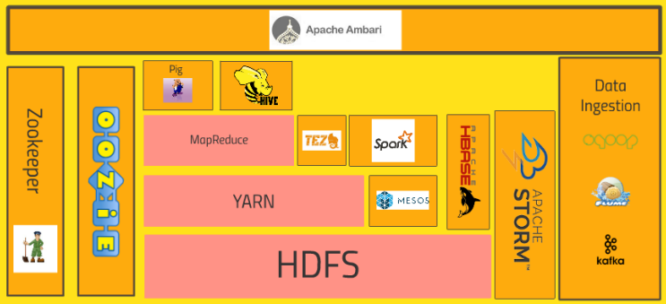
Apache Hadoop

Slide 59
Hadoop Distributed File System (HDFS)
HDFS is a distributed file system that provides scalable and reliable storage for large datasets across a cluster of computers.
It stores data in a distributed manner across multiple nodes in the cluster, with replication to ensure fault tolerance and data durability.
HDFS is optimized for high-throughput data access and is well-suited for storing large files, such as log files, sensor data, and web documents.

Slide 60
MapReduce
MapReduce is a programming model and processing engine for parallel data processing in Hadoop.
It divides tasks into smaller sub-tasks called "map" and "reduce" tasks, which are distributed across nodes in the cluster for parallel execution.
MapReduce is used for batch processing of large datasets, such as log analysis, ETL (Extract, Transform, Load) operations, and data aggregation.

Slide 61
YARN (Yet Another Resource Negotiator):
YARN is a resource management and job scheduling framework that manages computing resources (CPU, memory) across nodes in the Hadoop cluster.
It allows multiple data processing frameworks to run concurrently on the same cluster, enabling more flexible and efficient resource utilization.
YARN decouples the resource management layer from the processing framework, providing a more scalable and versatile architecture.

Slide 62
Hadoop Common:
Hadoop Common includes a set of utilities, libraries, and tools that provide common functionality for the Hadoop ecosystem.
It includes components such as the Hadoop Distributed Copy (DistCp) tool for data copying, Hadoop Archive (HAR) for archiving data, and Hadoop RPC (Remote Procedure Call) framework for communication between nodes.

Slide 63
Ecosystem of Tools and Projects
Hadoop has a rich ecosystem of tools and projects that extend its functionality and capabilities for various use cases.
These include higher-level data processing frameworks like Apache Hive for SQL-like querying, Apache Pig for data flow scripting, Apache HBase for NoSQL database operations, Apache Spark for in-memory processing, and more.

Slide 64
Hadoop
Apache Hadoop is widely used across industries for various big data applications, including data warehousing, log analysis, recommendation systems, fraud detection, and genomic analysis. It provides a scalable and cost-effective platform for processing and analyzing large volumes of data, enabling organizations to derive valuable insights and drive informed decision-making.

